Slide 1
USAG Wiesbaden
Michael K. Houston
Exercise Design & Control Lead
Justin D. Martin
Modeling & Simulations Engineer
FY-21 FSE Introduction
Version Number 1
As of 1 Dec 2020

Slide 2
HQDA EXORD 067-19
Army Campaign Plan 2019+; specifically Objective 1-1
“By building, sustaining, and training to deliver core capabilities needed to prevent, protect, mitigate, respond, and recover (P2MR2) from all-hazards consequences affecting the installation community, Installations enable the Army’s ability to calibrate force posture geographically and across all Army components, set the theater, and deliver precision logistics that provide layered, agile, and responsive sustainment capability necessary to support operations from the Strategic Support Area to the Deep Maneuver Area.”

Slide 3
Command Priorities
IMCOM Command Priorities
Current Focus Areas
SSA FOCUS AREAS:
Campaign Plan LOEs
COVID–19 Support & Recovery Operations
MDEP Reviews & POM Process
Facility Investment Plan (FIP) (MILCON, SRM) & Battle Rhythm
Housing Investment Plan (HIP)
Strategic MWR Way forward
Project Inclusion (Diversity, Equity & Inclusion)
QoL Initiatives and Updates
CDC/CYS Child Care Prioritization
Contract/Acquisition Review Board
AMC 23 (Specials)
Digital Garrison app (DG)
MDM & RCI Incent Fees Review
AR 600-20 (rapid change revision)
Summer Surge II/Data Analytics
Standardization & P/D Associated w/MILCON
BUILDER Transition
Advancing SABRE => VANTAGE; Knowledge Mgmt
Data Analytics Management & Information
GPCC/SCC Education Reform
Displaced Family Tracker & Status
IMCOM Strategic Comms Plan/Branding
Audit Readiness
CLS 2.0, Campaign
ISR-S Revised
FISMA Compliance
PHEMS
1.0 - Soldier, Civilian, & Family Readiness
2.0 - Installation Readiness
3.0 - Industrial Base Readiness
4.0 - Munitions Readiness
5.0 - Strategic Power Projection
6.0 - Supply Avail & Equip Readiness
7.0 - Data Analytics & Logistics Info Readiness
People
Infrastructure
BASOPS/Spt Svcs
(What we deliver)
4. Enterprise Mgt
(How we deliver)
IMCOM Enduring Priorities
1. Soldier/Family Programs
2. Infrastructure
3. Support to Training
4. Protection
CSA PRIORITIES: PEOPLE (Housing/Childcare/Spouse Employment/PCS-HHG/Healthcare), READINESS, MODERNIZATION, REFORM
Key Upcoming Events
Key Upcoming Decisions/Coordinating Actions
Housing/Barracks
RCI Project Reinvest Plan (roles/response), Incentive fee structure & process, Facility Investment Plan (FIP), Housing Investment Plan (HIP)
IMCOM Weekly Housing Review: Every Monday (weeks 1-5)
RCI CEO Roundtable w/GEN Daly: 6th Monday (week 6), 26 Oct
CG/ID NETCALL: 28 Oct
Senior Commander Course: 19-23 Oct (NCR/RSA)
ReARMM ROC Drill, 22 Oct
AMC CDRs Forum, 29 Oct (CG @ HSV)
FIP Program Review 3 Star GOSC back brief D4, 30 Oct 20
GPCC: 26–31 Oct (Virtual)
HQ IMCOM Newcomer’s Brief, 4 Nov
FIP Program Review w/D4, 13 Nov
Garrison Commanders Conference: 16-20 Nov (Virtual)
SSA Forum (1,2,5), 19 Nov
MSC Update, 17 Dec
AMC Housing App – Pilot (FCKY & USAG Bavaria)
Contract Management Review (w/G8/MICC)
AMC OPORD 20-135, Reassignment of AMC Installations to IMCOM
Southwest Border Mission (TBD), Pending EXORD
CYS Hourly Care Pilot Locations (Meade, Belvoir, Hawaii, Wainwright, Bragg)
Army Family Web Portal Launch – CLOUD Migration (AMC G6, IMCOM G6 & G9)
AMC Strategic Battle Rhythm Events
AMC CUB: Every other Thursday
AMC Cmd & Staff: 29 Oct (4th Thu of the month)
ORU: 18 Nov
POM Off Site: 3 Dec
16 Oct 20
BG James S Moore/210-466-7566/ james.s.moore.mil@mail.mil

Slide 4
HQ IMCOM Full Scale Exercise (FSE) Support
HQ IMCOM PM/P manages, standardizes and resources a full-scale disaster response exercise program for U.S. Army installations worldwide.
ATS supports this program by:
Assisting garrisons with exercise design, planning and event control
Enabling IMCOM evaluators to observe installations exercise their mission areas and core capabilities
Leveraging simulation software and expertise to add realism and rigor to IMCOM exercises
Providing a flexible exercise framework that enables senior leaders to adjust intensity and focus in real-time
Key Milestones
Concept & Objectives Brief
Initial/Mid/Final Planning Meetings
MSEL Conference
FSE Execution

Slide 5
Agenda
How we plan
Communicating
Decision Support Products
Planning & Execution Support Products
Pre-Planning Installation Review
Contact Information

Slide 6
How we plan
Regulatory Guidance
ATS follows DoD, Army, and IMCOM guidance on following the DHS Homeland Security Exercise and Evaluation Guidelines (HSEEP) for exercise design and execution.
Incorporates requirements outlined in:
IMCOM OPORD 19-061 IMCOM FSE Program Implementation 21 Aug 2019
Homeland Security Presidential Directive 8, National Preparedness, 21 October 2011
Homeland Security Exercise and Evaluation Program Exercise Evaluation Program, April 2013
National Preparedness Goal, 2nd edition, June 2016
DoDI 2000.16, DoD Antiterrorism (AT) Program, 5 May 2017
DoDI 6055.17, Installation Emergency Management (IEM) Program, 31 August 2018
FM 7-0, Train to Win in a Complex World, 5 October 2016
AR 525-2, The Army Protection Program, 8 December 2014
AR 525-13, Antiterrorism, 17 February 17
AR 525-27, Army Emergency Management Program, 29 March2019
Army Doctrine Publication (ADP) 7-0, Training Units and Developing Leaders, 29 August 2018
DA PAM 525-27, Army Emergency Management Program, 20 September 2012
TRADOC PAM 525-3-1, The US Army in Multi-Domain Operations 2028, 16 December 18
HQDA EXORD 067-19 – Army Campaign Plan 2019+.
IMCOM Exercise & Evaluation Guidelines
Results in Standardized Planning & Execution Processes

Slide 7
Communicating
How we work as a team! Combining the JELC with HSEEP
The PO&AM – Program of Objectives and Milestones
IPRs
Monthly to Weekly– tracks progress of planning effort – ensures synchronization
Concept and Objectives Meeting (C&O)
Soon! Establishes the exercise design – initiates planning with key planners
Initial Planning Meeting
Follows C&O – with Directorate/Participant Trusted Agents to Introduce the plan, establish work assignments, identify subordinate (SMART) training objectives
Mid-Term Planning Meeting
Making Sausage, MSEL Development
Final Planning Meeting
Conditions Check prior to execution
Exercise!
Coordinate with Evaluation team to brief exercise objectives, construct, core capabilities

Slide 8
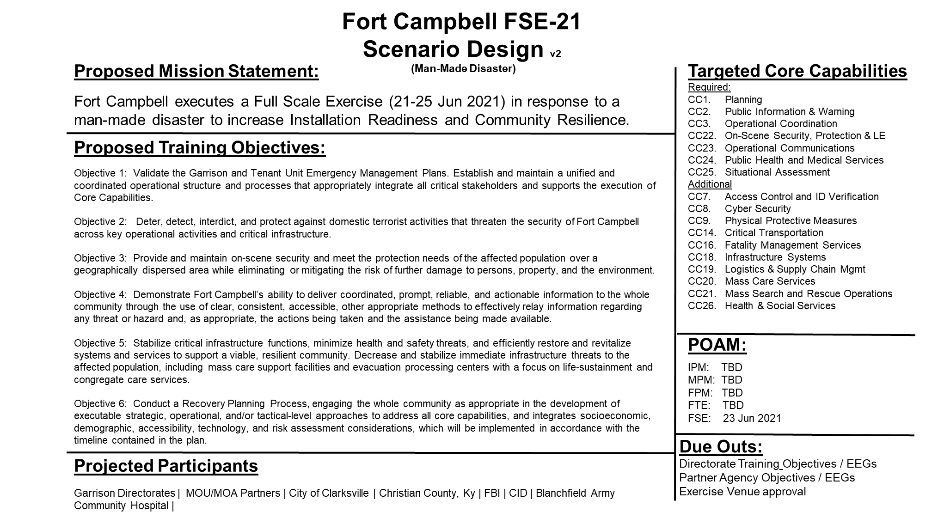
Decision Support Products
The Quad (+) Chart Front Page
EXAMPLE
Front page viewable by all planners

Slide 9
Decision Support Products
The Quad (+) Chart Back Page
Scenario: Pre-exercise intel updates create conditions to raise FPCON levels. Coordinated Attacks create a MASCAL and multiple fatality event and hostages at the soldier support center, shutting down operations and creating a complex response operation requiring the Eagle Guard IRF to employ. A concurrent dirty bomb is discovered entering Gate 7 complicates response efforts and employment of EOD and evacuation of housing areas.
Expected Response Activities: Extensive LE/Fire/EMS response (MOU/MOA partner involvement), FPCON change, EOD & CID involvement (hostage negotiation), Fatality Management and Critical Transportation, accountability drills, partner agency coordination. Significant PAO activities (JIC).
Operational Risk (Exercise Risk to Mission Assurance): If the functions at the Soldier Support Center participate as a validation of their EM Plan, services would be disrupted for one day for the FSE.
Environmental Risk: N/A
EXAMPLE
Viewable by Key Planners and Installation Leadership

Slide 10
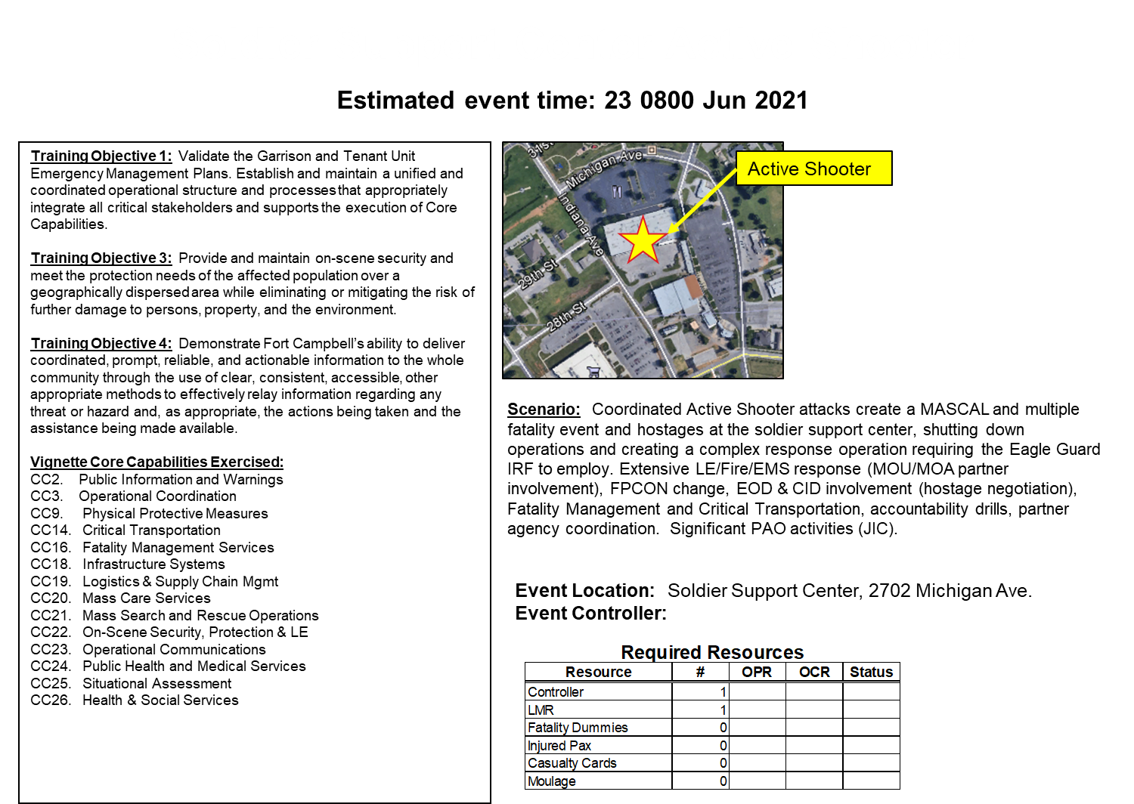
Decision Support Products
Vignettes

Slide 11
Planning & Execution Support Products
Facilitate Alignment, Communication, and Understanding
Detailed task flow chart demonstrates ESF/Directorate roles and task linkage

Slide 12
Planning & Execution Support Products
Facilitate Alignment, Communication, and Understanding
Spider Chart – Directorate/ESF linkage to core capabilities.

Slide 13
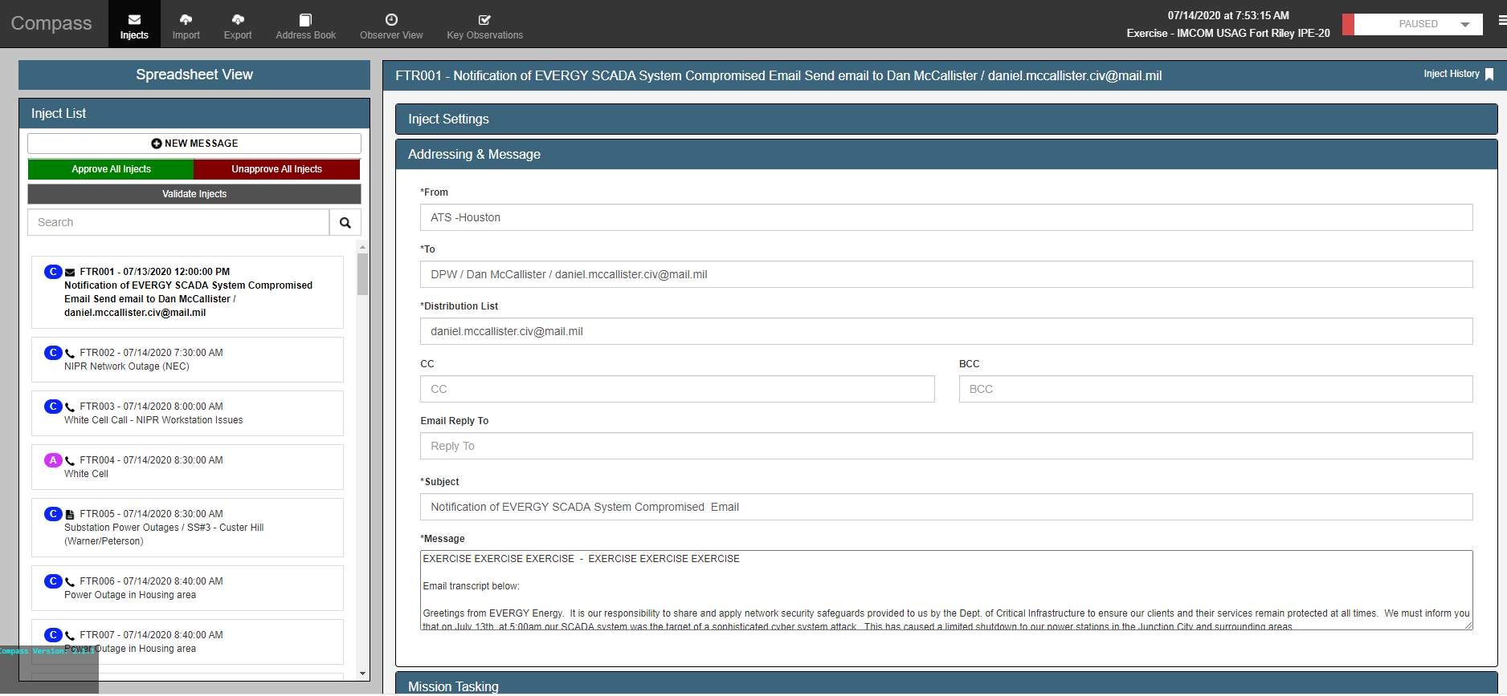
Planning & Execution Support Products
Facilitate Alignment, Communication, and Understanding
Master Scenario Events List (MSEL) – Events and Injects that generate task performance aligned to Core Capabilities.
https://imcom.atssim.com

Slide 14
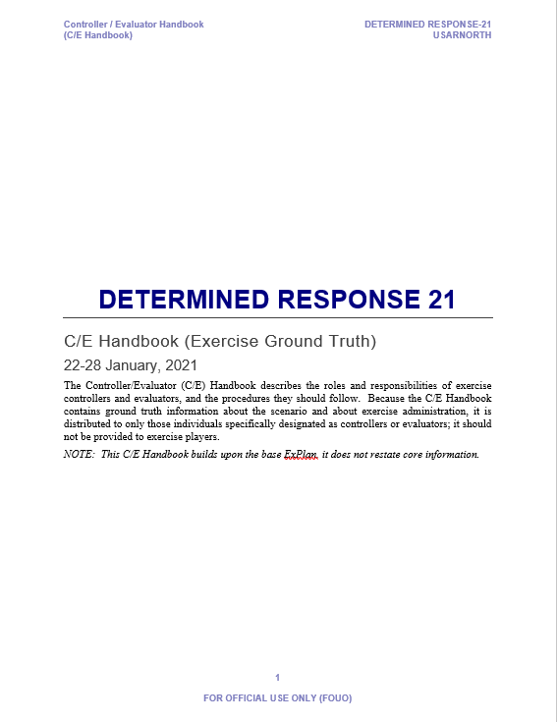
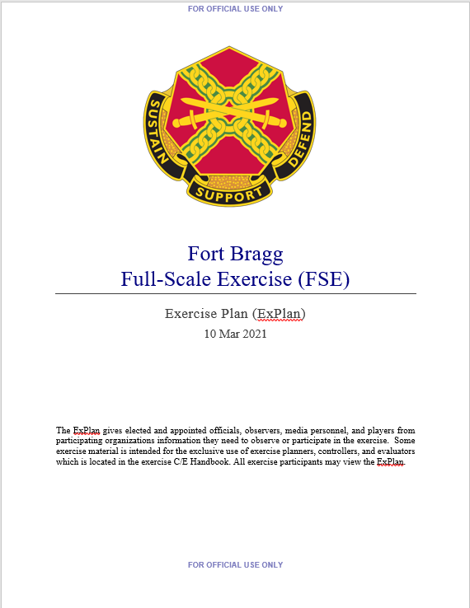
Planning & Execution Support Products
Facilitate Alignment, Communication, and Understanding
Exercise Plan (ExPlan) & Controller Evaluator Handbook (C/E Handbook)
ExPlan – Generic Exercise information for all participants to review – basic instructions on how the exercise will work and what the goals of the exercise are.
C/E Handbook – Detailed exercise information (Scenario, Objectives, Injects, Maps, etc) for leadership, ExCon personnel, and OC/Ts-Observers to facilitate the execution and observation processes.
ATS develops the 90% DRAFT for installations

Slide 15
Planning & Execution Support Products
Facilitate Alignment, Communication, and Understanding
Simulations Support
ATS uses proprietary software applications to add fidelity, realism and stimulus to disaster response exercises, while reducing manpower requirements and technical complexity.
ATS software applications are web-based, requiring only internet access for the White Cell to edit and manage exercise data.
Key software features include:
Management of all exercise MSEL injects and their captured observations
Representation of physically-unavailable resources, threats, and their actions
Stimulation of COP maps and dashboards (e.g., WebEOC, PSIF, Google Earth)
Emulation of social media platforms in a self-contained exercise environment
ATS software is delivered, set-up and run by a M&S engineer embedded in the exercise White Cell.

Slide 16
Pre-Planning Installation Review
The Way Ahead
MTEP Review – Where you are in your training continuum
Threat & Hazard Identification & Risk Assessment (THIRA) Review – What you believe are your threats to executing your Army mission (Mission Assurance disruptions).
Past Performance Review
Previous AARs, CAP, HHAs, etc.
GC’s Initial Exercise Training Guidance
Site Survey
GC Desk-side – Program Introduction (this slide deck); Updated Exercise training guidance, etc.
Directorate/Trusted Agent Introductory Brief (this slide deck)
Review physical exercise locations
Identify/Review White Cell/EXCON location
Workspace for up to 8 pax
Network Connectivity (dirty internet, wifi preferred)
Phones (up to 8)
Proximity to EOC
Power availability for up to 8 workstations
NEC compliance (if required & different than IMCOM HQ)

Slide 17
Pre-Planning Installation Review
The Way Ahead
Complete Site Visit (C&O Meeting / IPM)
Establish Planning Milestones
Conduct MPM / MSEL Conference / FPM
FSE Week
Establish on-site White Cell
Conduct GC desk-side & FSE in-brief
Conduct FSE
Participate in AAR development and Eval. Team out-brief
Submit trip report to HQ IMCOM

Slide 18
Contact Information
Mike Houston, COL (Ret)
Exercise Design and Control Lead, IMCOM
Contractor, Applied Training Solutions
mhouston@appliedtrg.com
Cell: (512) 695-4931
Mike Dolata, COL (Ret)
Program Manager, IMCOM
Contractor, Applied Training Solutions
idolata@appliedtrg.com
(210) 466-0375
Justin Martin
Modeling & Simulation Engineer, IMCOM
Contractor, Capstone Corporation
Justin.d.martin@capstonecorp.com
Cell: (757) 869-1229

