Slide 1
FY21 Full Scale Exercise (FSE) Tornado Overview 2 December 2020
Tamilene Black
EM Specialist
USAG-R DO
Version Number 2
As of 2 December 2020

Slide 2
FY 21 FSE Agenda
GOAL: To gain the GC’s approval of FSE design & scope to initiate detailed planning.
OBJECTIVES:
Present Commander’s Decision Points for approval
Discuss FY21 FSE Concept / Scenario
Review Planning and Execution Timelines (PO&AM)
Receive GC’s Exercise Training Guidance
CUI
2 of XX

Slide 3
FY 21 FSE Commander’s Decision Points
Concue
1
Approve the Mission Statement
Approve Exercise Training Objectives
Approve the Exercise Scenario
Approve the Scope
2
3
4
CUI
3 of XX

Slide 4
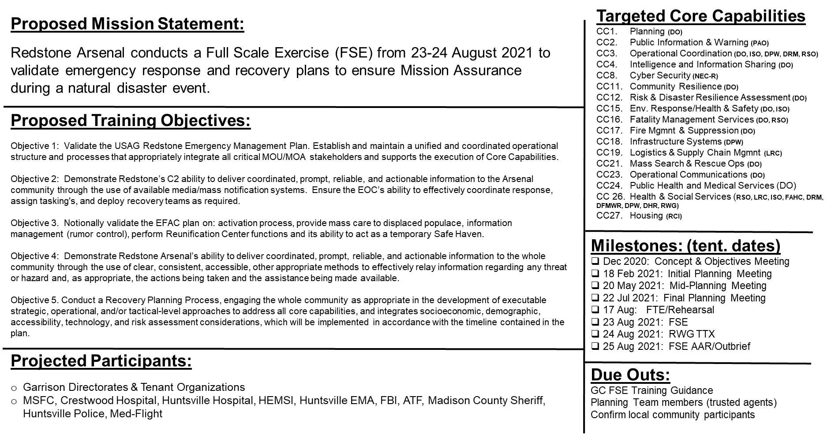
USAG Redstone Arsenal FY-21 FSE Design
1
2
CUI
4 of XX

Slide 5
USAG Redstone Arsenal FY-21
Scenario/Sequence of Events:
Huntsville and RSA receive severe weather watches and warnings, culminating in a tornado touching down along the I565 corridor. The tornado causes significant damage and creates numerous injury, MASCAL, and fatality events disrupting mission essential services. During the response and recovery activities, an unknown entity initiates a cyber attack on critical infrastructure, complicating the effort.
Scope & Expected Response Activities: Mass notification and response and recovery activities will require significant coordination with installation and community partners, activation of the garrison EOC, ICS, emergency response personnel, EFAC functions, accountability, public information, damage assessment, and sheltering. A recovery working group TTX will occur on day 2. Damage/injury/fatality locations include:
RSA Airfield tower and hanger damaged (notional)
Primary power station #1 zones ALPHA and BRAVO power loss (notional)
Gate 9 destroyed, injuries, and blocked passage
FAHC damaged, multiple injuries (notional)
Housing Area with numerous homes destroyed, injuries, fatalities, and displaced persons (notional)
Louis Morris Elementary damaged with students trapped, injuries
Operational Risk (Exercise Risk to Mission Assurance): None
Environmental Risk: None
3
4

Slide 6
GC’s Exercise Training Guidance
CUI
6 of XX

Slide 7
Backup Slides

Slide 8
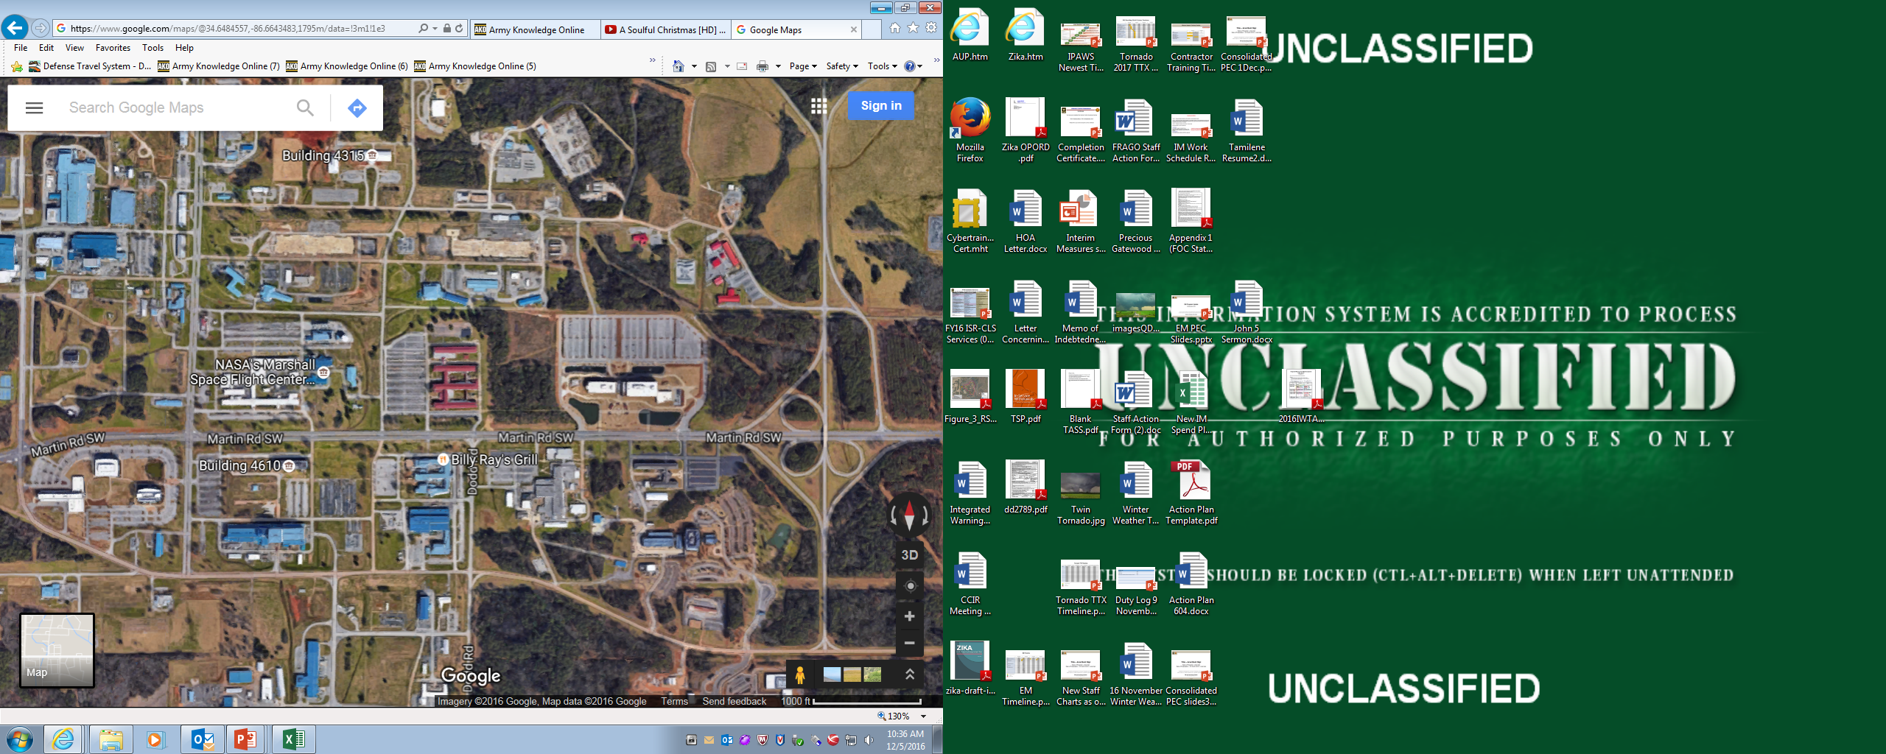
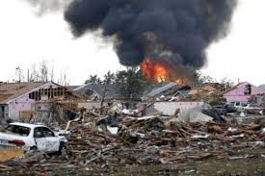
FSE Overview
FY 21 Full Scale Exercise Overview
Day 1: 23 August 2021
Day 2: 24 August 2021
Recovery Phase TTX
Hospitals
Capabilities
1. Planning
2. Public Information and Warning
3. Operational Coordination
4. Intelligence & Information Warning
6. Forensics & Attribution (added)
16. Fatality Management (added)
22. On-Scene Security, Protection & LE
23. Operational Communications
24. Public Health & Medical Services
25. Situational Assessment
26: Health & Social Services (added)
Huntsville
Crestwood
Madison
County EMA
State EOC
National Guard F-Division
EXERCISE GOAL: Exercise and Validate Installation Response and Recovery Plans/Procedures.
Objectives:
Validate portions of Installation Emergency Operations Plan (Capabilities 1-26)
Validate Facility EAP’s (Capability 3)
Validate DO Incident Action Plans (Capability 3,6,16,22,23,24)
Validate ICP Operations and Procedures (Capability 21)
Validate Search and Rescue Procedures (Capability 22)
Validate CrMT Operations (Capability 1,2, 3, 23)
Validate MOUs/MOAs (Capability 1, 3)
Test Installation Mass Notification Systems (Giant Voice, Public Address, Alert and Web EOC) (Capability 2)
Validate Reporting Procedures (SIR’s, OPREP’s and EXSUM’s) (Capability 4)
Validate Public Information Procedures (Press release, JIC activation and Email messaging) (Capability 2)
Personnel Accountability Procedures (Capability 3,23)
Weather Assessment Activities (Capability 1, 2, 3, 23)
Damage Assessment Activities (Capability 25)
CUI
8 of XX

Slide 9
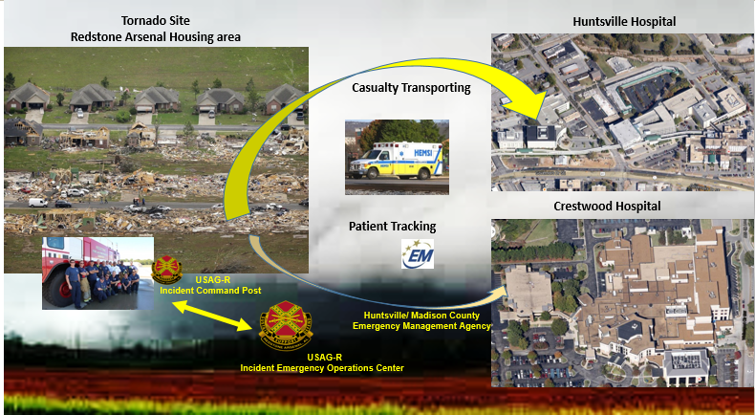
FSE Concept
FY21 FSE Concept
DAY #1: 23 August 2021
Exercise Components
RSA receives simulated severe weather briefing one day prior to event.
RSA goes under a tornado watch followed by a tornado warning the morning of exercise.
Tornado touches down along the I-565 corridor around 0845hrs.
The exercise white cell planning team releases varies injects to assist in validating installation capabilities and response efforts. Observer controllers will be positioned at various locations (ICP, IEOC and incident areas).
Varies assets will be “notionally” destroyed. However, no elements will respond to these locations. First responder actions will be simulated. Only one location will be used to assess incident response and recovery efforts.
The housing area will be the exercise play area. The White Cell planning team will identify specific locations and varies assets to mock up destroyed or partially collapsed facilities.
Exercise will transition to a pause-ex at 1400hrs in order to prepare for the day 2 recovery portion of the exercise.
FSE: Full-Scale Exercise is a multi-agency, multi-jurisdictional, multi­discipline exercise involving functional and "boots on the ground" response.
CUI
9 of XX

Slide 10
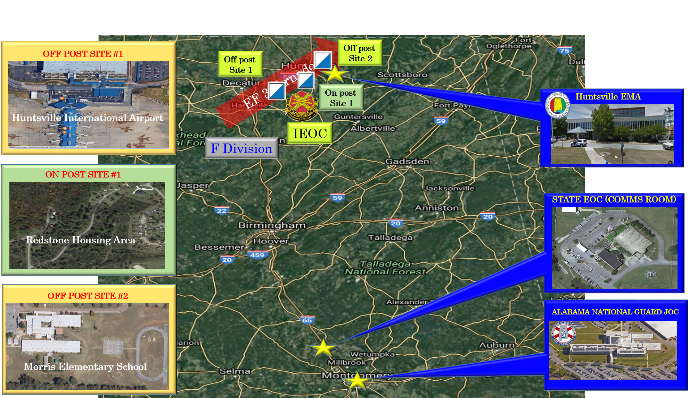
FSE Scenario Examples
Tornado Impact
Huntsville Assets: Will be notional incidents in the exercise scenario. The off post scenario is designed to provide challenges for MOU/ MOA support and decision making requirements.
#1. Huntsville international Airport: Terminal partially destroyed, partial collapse of baggage claim area, casualties reported in ticket counter area
#2: RSA Airfield: AF tower and hanger partially destroyed. No casualties reported.
#3: Primary #1:(station destroyed. Zones ALPHA and BRAVO without power.
#4: Gate #9: Gate 9 destroyed. Various vehicle wreckage. Area is not passible. Various injuries reported.
#5: FAHC: FAHC partially destroyed. Various injuries reported.
#6: Housing Area: (Exercise Play Area)
#7: Louis Morris Elementary School: Partially destroyed, students trapped in gym area.
4
3
2
1
1
CUI
10 of XX

Slide 11
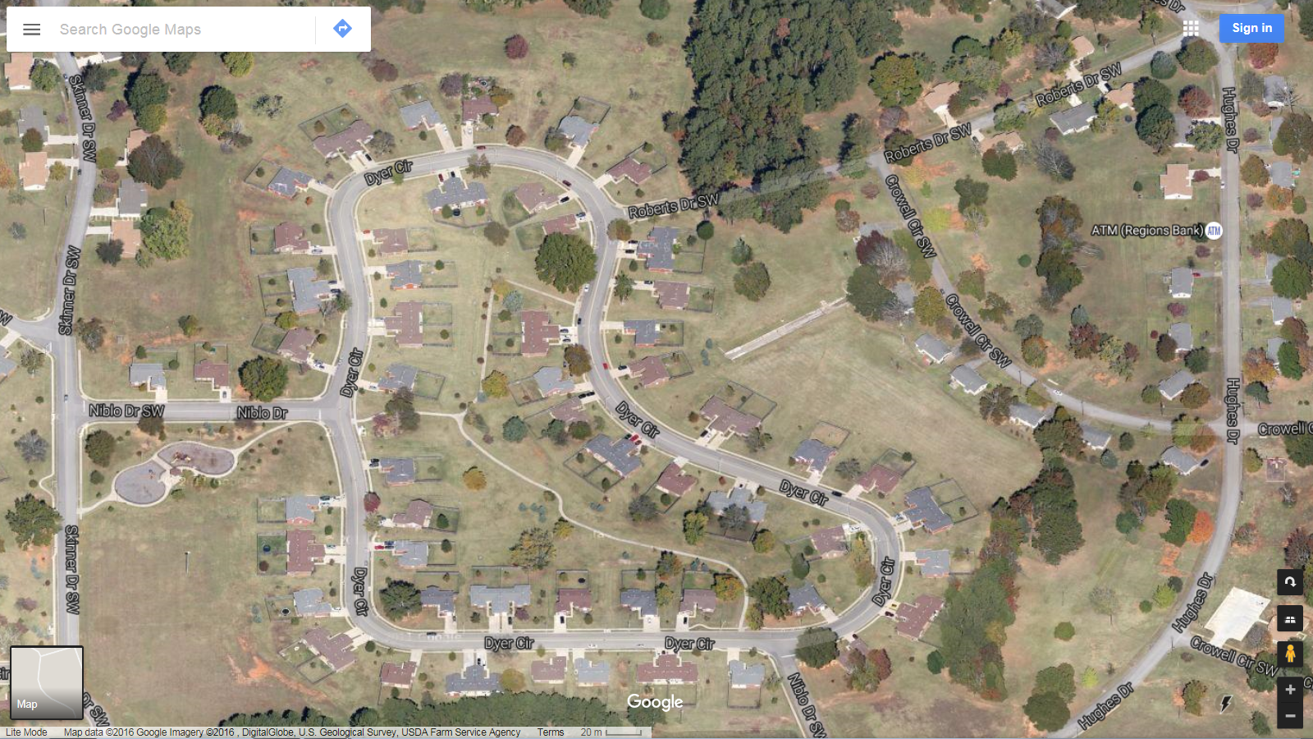
FSE Scenario Impacts to Housing Area
Redstone Arsenal: Challenger Heights Housing Area
Redstone Arsenal Housing Area
21 Homes destroyed:
19 Homes damaged
6 DOA’s (3 Adults & 3 Kids)
34 Injuries (16 Adults & 18 Kids)
16 Entrapments
40 Displaced personnel
Entrapment
Damaged
Damaged
Damaged
Damaged
Damaged
Damaged
Damaged
Destroyed
Damaged
Damaged
Damaged
Destroyed
Damaged
Destroyed
Destroyed
Destroyed
Damaged
Destroyed
Destroyed
Damaged
Destroyed
Destroyed
Entrapment
Damaged
Destroyed
Destroyed
Destroyed
Destroyed
Destroyed
Damaged
Damaged
Damaged
Destroyed
Destroyed
Destroyed
Destroyed
Destroyed
Damaged
Entrapment
Destroyed
Damaged
Destroyed
Entrapment
Entrapment
Entrapment
CUI
11 of XX

Slide 12
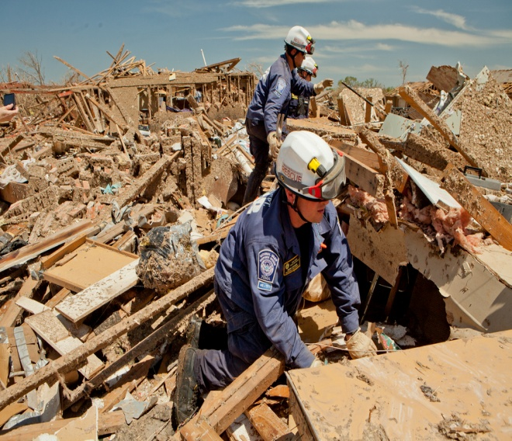
RWG TTX Overview
Tornado Recovery TTX
DAY #2: 24 August 2021
Exercise Components
The FSE will transition to a pause-ex at 1400hrs on 24 August in order to transition to recovery portion of the exercise. The recovery exercise will validate plans and procedures identified during the Tornado TTX.
ICP and CrMT will assemble at their respected locations at 0830hrs in order to resume exercise.
ICP will formally transfer from incident response to recovery efforts.
CrMT will conduct a shift change brief and assist the ICP in recovery operations.
The exercise white cell planning team will continue releasing exercise injects to assist in validating exercise recovery efforts. Observer Controllers will continue to assess their assigned areas.
The recovery exercise will endex at 1530hrs.
A hot wash will be conducted immediately after.
TTX: Table Top Exercise is a real-time scenario with movement of personnel and equipment in support of a single-agency and/or single-hazard set of requirements.
CUI
12 of XX

Slide 13
HSEEP 27 Capabilities
Capabilities
The HSEEP 27 Capabilities requiring evaluation and Commander’s T,P,U assessment
Common
1 | Planning (ESF #5)
2 | Public Information and Warning (ESF #2 & 15)
3 | Operational Coordination (ESF #5)
Prevent
4 | Intelligence & Information Warning (ESF #13)
5 | Screening, Searching and Detection (ESF #13)
6 | Forensics & Attribution (ESF #13)
Protection
7 | Access Control & ID Verification (ESF #13)
8 | Cyber Security (ESF #13)
9 | Physical Protective Measures (ESF #13)
10 | Risk Mitigation For Protection Programs (ESF #13)
Mitigation
11 | Community Resilience (ESF #5 )
12 | Risk & Disaster Resilience Assessment (ESF #5)
13 | Threat & Hazard Identification (ESF #5)
Response
14 | Critical Transportation (ESF #1)
15 | Environmental Response/Health & Safety (4,9,13)
16 | Fatality Management (ESF #8)
17 | Fire Management & Suppression (ESF #4)
18 | Infrastructure Systems(ESF #3 & 12)
19 | Logistics & Supply Chain Management (ESF #7)
20 | Mass Care Services (ESF #6)
21 | Mass Search & Rescue Ops (ESF #9)
22 | On-Scene Security, Protection & LE (ESF #13)
23 | Operational Communications (ESF #2)
24 | Public Health & Medical Services (ESF #8)
25 | Situational Assessment (ESF #5)
Recovery
26 | Health & Social Services (ESF #8)
27 | Housing (ESF #7 & 14)
Green highlighted rows (5,7,9, and 17) signify those capabilities that may be demonstrated on an almost daily basis
The yellow highlighted rows (1,2,3,4,13,15,22,23,24, and 25) signify those capabilities that should be demonstrated/assessed during operations based, integrated protection exercises and evaluated FSEs
The blue highlighted rows (6,8,10,11,12,14,16,18,19,20,21,26 and 27) signify those capabilities that are required to be demonstrated/evaluated over the three year triennial period as outlined in submitted multi-year training plans.
CUI
13 of XX

Slide 14
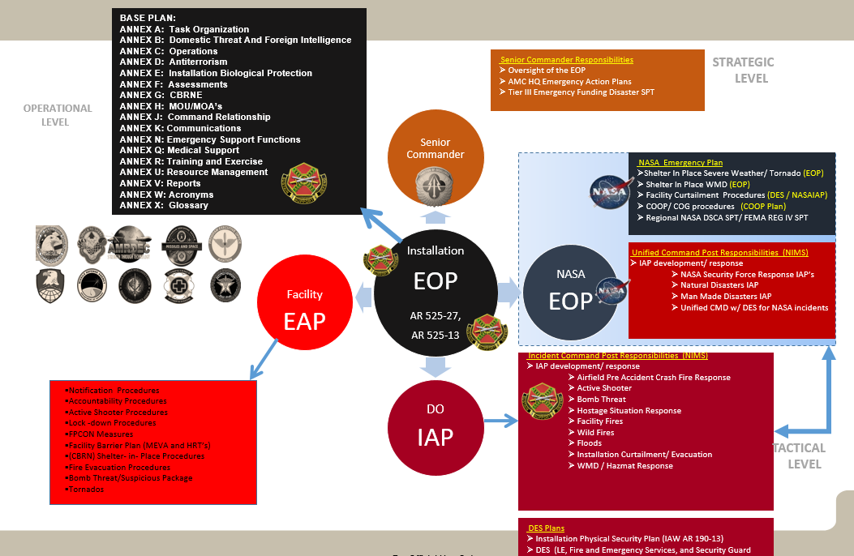
Capability Assessment Process
Targeted Core Capability
# | Garrison Capabilities: | SGO/OPR | (T/P/U) Before FSE | (T/P/U) After FSE
Common
1 | Planning (ESF #5) | DO | P | P
Planning encompasses some of the following items
Garrison and Installation Level: Emergency Operations Plan (EOP), CRMT SOP, First responder incident response and recovery SOP’s and checklist, MOU and MOA’s.
Organizational and facility level: Facility Emergency Action Plans (EAP)
CUI
14 of XX

Slide 15
Capability Assessment FY 19 FSE
# | Garrison Capabilities: | SGO/OPR | (T/P/U) Before FSE | (T/P/U) After FSE
Common
1 | Planning (ESF #5) | DO | P | P
2 | Public Information and Warning (ESF #2 & 15) | PAO | P | P
3 | Operational Coordination (ESF #5) | DO | P | P
Prevent
4 | Intelligence & Information Warning (ESF #13) | DO | T | P
5 | Screening, Searching and Detection (ESF #13) | DO | P | P
6 | Forensics & Attribution (ESF #13) | CID | T | P
Protection
7 | Access Control & ID Verification (ESF #13) | DO | P | P
8 | Cyber Security (ESF #13) | RNEC-R | TBD | TBD
9 | Physical Protective Measures (ESF #13) | DO | T | T
10 | Risk Mitigation For Protection Programs (ESF #13) | DO | P | P
Mitigation
11 | Community Resilience (ESF #5 ) | DO | T | T
12 | Risk & Disaster Resilience Assessment (ESF #5) | DO | TBD | TBD
13 | Threat & Hazard Identification (ESF #5) | DO | P | P
Response
14 | Critical Transportation (ESF #1) | DO | P | P
15 | Environmental Response/Health & Safety (4,9,13) | DO | P | P
16 | Fatality Management (ESF #8) | DHR | P | P
17 | Fire Management & Suppression (ESF #4) | DO | T | T
18 | Infrastructure Systems(ESF #3 & 12) | DPW | P | P
19 | Logistics & Supply Chain Management (ESF #7) | LRC | P | P
20 | Mass Care Services (ESF #6) | DFMWR | P | P
21 | Mass Search & Rescue Ops (ESF #9) | DO | P | P
22 | On-Scene Security, Protection & LE (ESF #13) | DO | P | P
23 | Operational Communications (ESF #2) | DO | T | P
24 | Public Health & Medical Services (ESF #8) | DO | TBD | T
25 | Situational Assessment (ESF #5) | DO | T | P
Recovery
26 | Health & Social Services (ESF #8) | ACS | P | P
27 | Housing (ESF #7 & 14) | RCI | P | P
The following capabilities were downgraded from a
Trained to Needs Practice:
#4 - Intelligence and Information- A Emergency Threat
Working Group was not conducted during FSE.
#6 - Forensics & Attribution- Witness and Victim
Statuses were not clearly defined by First Responders.
#23 - Operational Communications- The EOC didn’t
Have a process in place for redundant communications.
#25 - Situational Assessment- CCIRs, Commander updates
And WebEOC entries did not reflect impacts of the
Incident on Garrison, Installation, or tenant missions
The following capabilities still need to be assessed:
#8 – Cyber Security
#12 – Risk and Disaster Resilience Assessment
T= Trained (90-100%)
P= Needs Practice (65-89%)
U= Untrained (Less than 65%)

Slide 16
FY 21 FSE Capabilities to be assessed
# | Garrison Capabilities: | SGO/OPR | (T/P/U)
Common
1 | Planning (ESF #5) | DO | P
2 | Public Information and Warning (ESF #2 & 15) | PAO | P
3 | Operational Coordination (ESF #5) | DO | P
Prevent
4 | Intelligence & Information Warning (ESF #13) | DO | P
5 | Screening, Searching and Detection (ESF #13) | DO | P
6 | Forensics & Attribution (ESF #13) | CID | P
Protection
7 | Access Control & ID Verification (ESF #13) | DO | P
8 | Cyber Security (ESF #13) | RNEC-R | TBD
9 | Physical Protective Measures (ESF #13) | DO | T
10 | Risk Mitigation For Protection Programs (ESF #13) | DO | P
Mitigation
11 | Community Resilience (ESF #5 ) | DO | T
12 | Risk & Disaster Resilience Assessment (ESF #5) | DO | TBD
13 | Threat & Hazard Identification (ESF #5) | DO | P
Response
14 | Critical Transportation (ESF #1) | DO | P
15 | Environmental Response/Health & Safety (4,9,13) | DO | P
16 | Fatality Management (ESF #8) | DHR | P
17 | Fire Management & Suppression (ESF #4) | DO | T
18 | Infrastructure Systems(ESF #3 & 12) | DPW | P
19 | Logistics & Supply Chain Management (ESF #7) | LRC | P
20 | Mass Care Services (ESF #6) | DFMWR | P
21 | Mass Search & Rescue Ops (ESF #9) | DO | P
22 | On-Scene Security, Protection & LE (ESF #13) | DO | P
23 | Operational Communications (ESF #2) | DO | P
24 | Public Health & Medical Services (ESF #8) | DO | T
25 | Situational Assessment (ESF #5) | DO | P
Recovery
26 | Health & Social Services (ESF #8) | ACS | P
27 | Housing (ESF #7 & 14) | RCI | P
The following capabilities were not assessed during FY 19 FSE and still need to be assessed:
#8 – Cyber Security
#12 – Risk and Disaster Resilience Assessment
CUI
16 of XX

