Slide 1
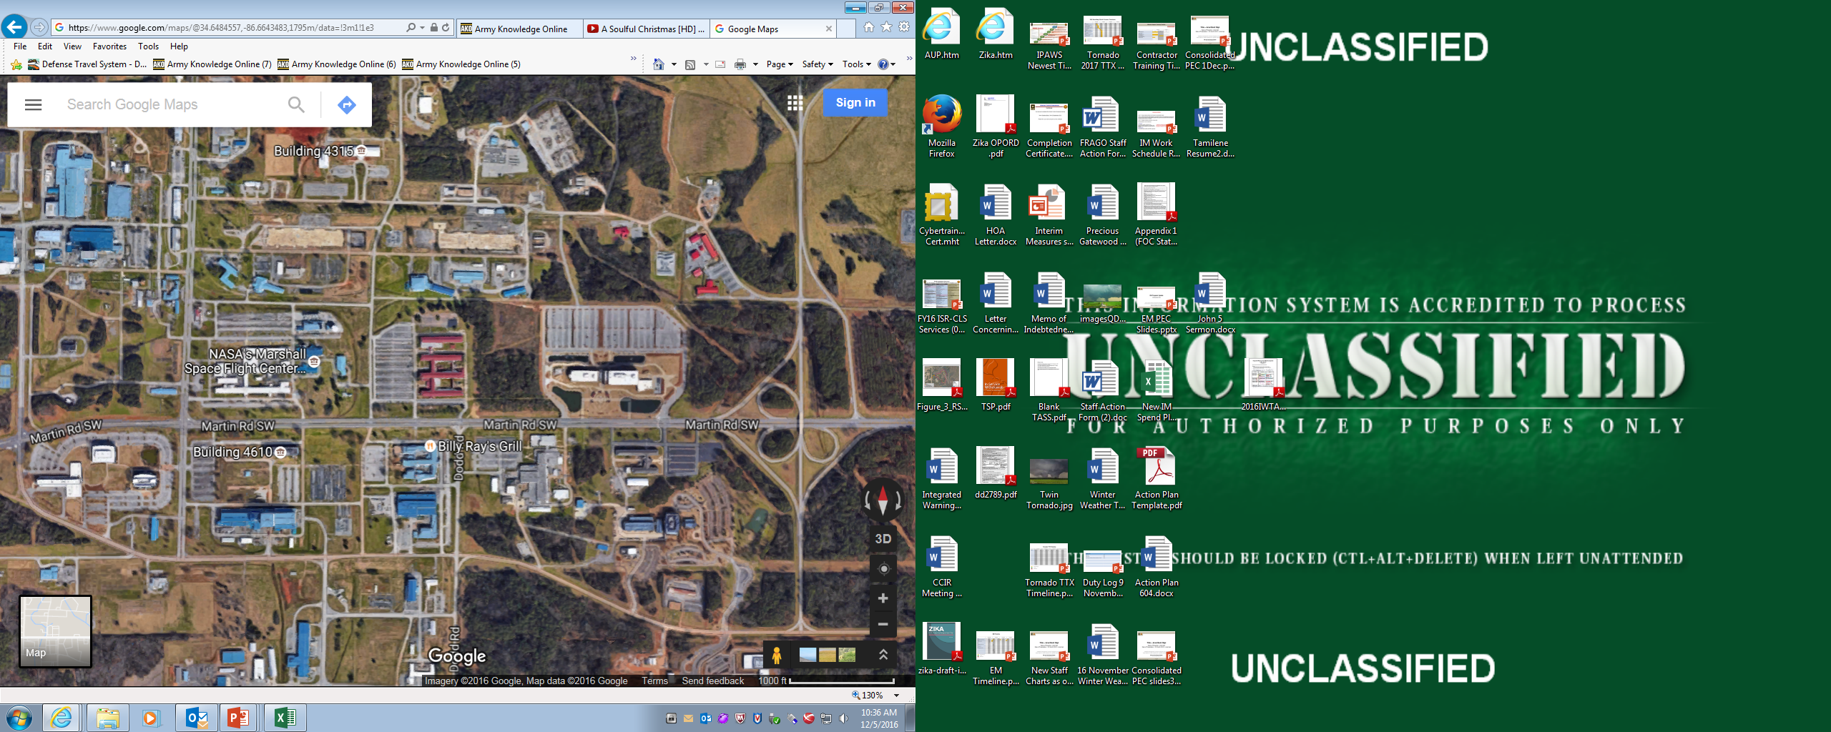
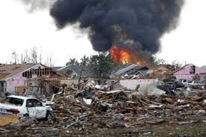
1st QTR FY21 Protection Working Group
FY 21 Full Scale Exercise Overview
Day 1: 23 August 2021
Day 2: 24 August 2021
Recovery Phase TTX
Hospitals
Capabilities
1. Planning
2. Public Information and Warning
3. Operational Coordination
4. Intelligence & Information Warning
6. Forensics & Attribution (added)
16. Fatality Management (added)
22. On-Scene Security, Protection & LE
23. Operational Communications
24. Public Health & Medical Services
25. Situational Assessment
26: Health & Social Services (added)
Huntsville
Crestwood
Madison
County EMA
State EOC
National Guard F-Division
EXERCISE GOAL: Exercise and Validate Installation Response and Recovery Plans/Procedures.
Objectives:
Validate portions of Installation Emergency Operations Plan (Capabilities 1-26)
Validate Facility EAP’s (Capability 3)
Validate DO Incident Action Plans (Capability 3,6,16,22,23,24)
Validate ICP Operations and Procedures (Capability 21)
Validate Search and Rescue Procedures (Capability 22)
Validate CrMT Operations (Capability 1,2, 3, 23)
Validate MOUs/MOAs (Capability 1, 3)
Test Installation Mass Notification Systems (Giant Voice, Public Address, Alert and Web EOC) (Capability 2)
Validate Reporting Procedures (SIR’s, OPREP’s and EXSUM’s) (Capability 4)
Validate Public Information Procedures (Press release, JIC activation and Email messaging) (Capability 2)
Personnel Accountability Procedures (Capability 3,23)
Weather Assessment Activities (Capability 1, 2, 3, 23)
Damage Assessment Activities (Capability 25)

