Slide 1
FY21 Full-Scale Exercise Vignettes
Mr. Ed Carnine
Emergency Manager
USAG Fort Stewart
As of 08/2020

Slide 2
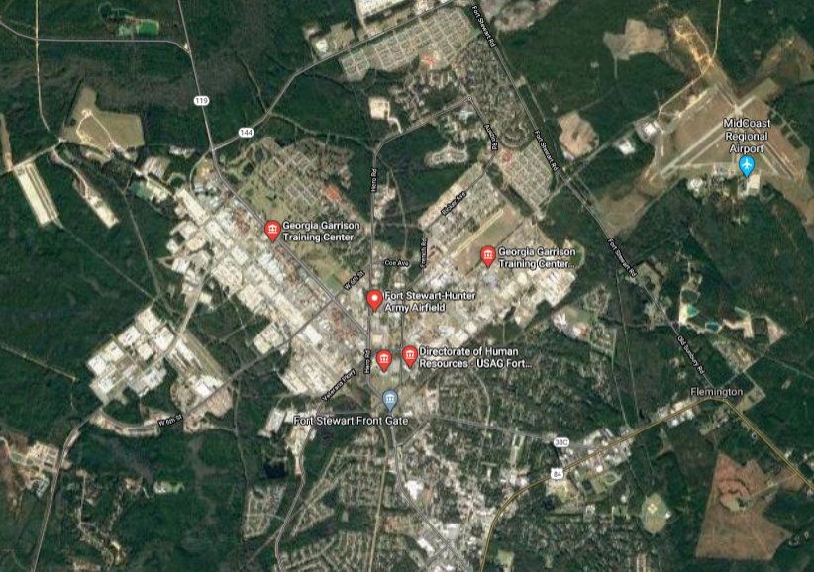
Full-Scale Exercise Overview
EXAMPLE
Toxic Plume
HAZMAT Spill
1
2
MASCAL
5
4
CASEVAC
EFAC Shelter
3
Evacuation Area

Slide 3
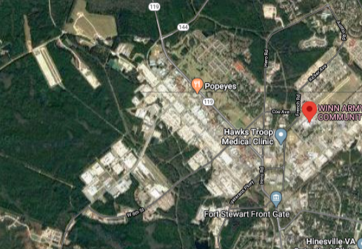
Site 1 – HAZMAT Spill
Vignette Scenario: During a Class 3 HAZMAT transportation, a 15,000gal tanker collides (or explodes via terrorist action) with another vehicle causing rupture of the liquid and spillage into the Little River vic. W. Manchester Road.
Training Objective #1: Validate the Fort Stewart Garrison Emergency Management Plan. Establish and maintain a unified and coordinated operational structure and processes that appropriately integrate all critical stakeholders and supports the execution of Core Capabilities.
Training Objective #4: Conduct appropriate measures to ensure the protection of the health and safety of the public and workers, as well as the environment, from all hazards in support of responder operations and the affected communities. Detect, assess, stabilize, and clean up releases of hazardous materials into the environment, including buildings/structures, and properly manage waste.
Vignette Core Capabilities Exercised:
CC1. Planning
CC2. Public Information & Warning
CC3. Operational Coordination
CC4. Intelligence and Information Sharing
CC13. Threat & Hazard Identification
CC15. Env. Response/Health & Safety
CC20. Mass Care Services
CC22. On-Scene Security, Protection & LE
CC23. Operational Communications
CC24. Public Health and Medical Services
CC25. Situational Assessment
CC26. Health & Social Services
HAZMAT Spill
EXAMPLE
1
Controller:
Phone:
LMR Freq:

Slide 4
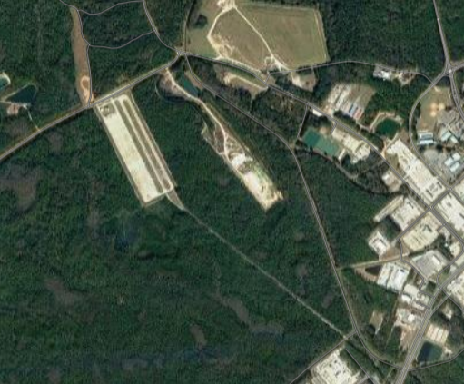
Site 2 – MASCAL
Vignette Scenario: Effects from Vignette #1 (downwind toxic plume) crosses the Blue Ramp, causing fatalities and casualties of numerous personnel in the vicinity.
Training Objective #1: Validate the Fort Stewart Garrison Emergency Management Plan. Establish and maintain a unified and coordinated operational structure and processes that appropriately integrate all critical stakeholders and supports the execution of Core Capabilities.
Training Objective #2: Demonstrate Fort Stewart’s ability to deliver coordinated, prompt, reliable, and actionable information to the whole community through the use of clear, consistent, accessible, other appropriate methods to effectively relay information regarding any threat or hazard and, as appropriate, the actions being taken and the assistance being made available.
Training Objective #4: Conduct appropriate measures to ensure the protection of the health and safety of the public and workers, as well as the environment, from all hazards in support of responder operations and the affected communities. Detect, assess, stabilize, and clean up releases of hazardous materials into the environment, including buildings/structures, and properly manage waste.
Vignette Core Capabilities Exercised:
CC1. Planning
CC2. Public Information & Warning
CC3. Operational Coordination
CC4. Intelligence and Information Sharing
CC11. Community Resilience
CC13. Threat & Hazard Identification
CC15. Env. Response/Health & Safety
CC20. Mass Care Services
CC22. On-Scene Security, Protection & LE
CC23. Operational Communications
CC24. Public Health and Medical Services
CC25. Situational Assessment
CC26. Health & Social Services
HAZMAT Spill
EXAMPLE
2
MASCAL
Controller:
Phone:
LMR Freq:

Slide 5
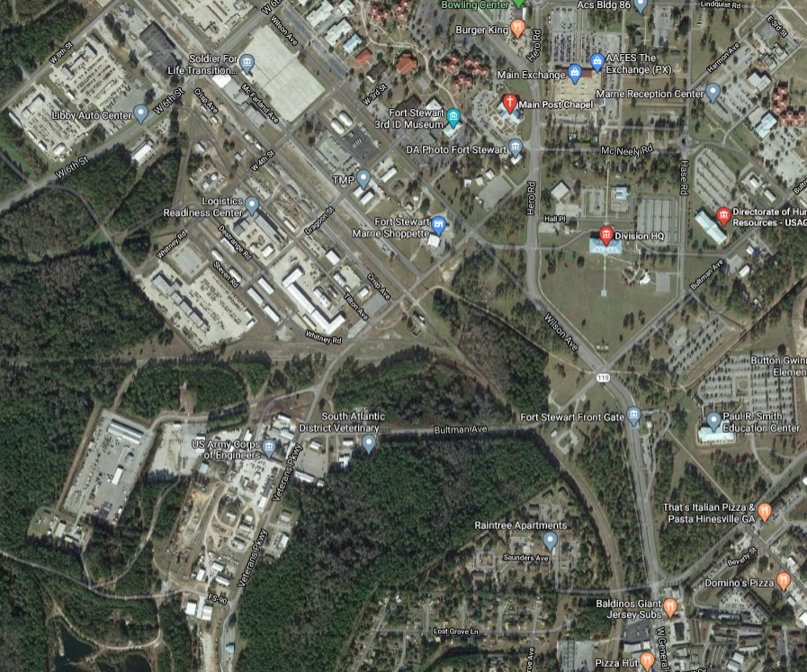
Site 3 – Evacuation
Vignette Scenario: Effects from Vignette #2 (downwind toxic plume) forces evacuations of personnel, medical response, temporary shelter, accountability drills and significant PAO activities.
Training Objective #2: Demonstrate Fort Stewart’s ability to deliver coordinated, prompt, reliable, and actionable information to the whole community through the use of clear, consistent, accessible, other appropriate methods to effectively relay information regarding any threat or hazard and, as appropriate, the actions being taken and the assistance being made available.
Training Objective #3: Validate the EFAC plan by providing life-sustaining and human services to the affected population, to include hydration, feeding, sheltering, temporary housing, evacuee support, reunification, and distribution of emergency supplies.
Training Objective #4: Conduct appropriate measures to ensure the protection of the health and safety of the public and workers, as well as the environment, from all hazards in support of responder operations and the affected communities. Detect, assess, stabilize, and clean up releases of hazardous materials into the environment, including buildings/structures, and properly manage waste.
Vignette Core Capabilities Exercised:
CC1. Planning
CC2. Public Information & Warning
CC3. Operational Coordination
CC4. Intelligence and Information Sharing
CC11. Community Resilience
CC13. Threat & Hazard Identification
CC15. Env. Response/Health & Safety
CC20. Mass Care Services
CC22. On-Scene Security, Protection & LE
CC23. Operational Communications
CC24. Public Health and Medical Services
CC25. Situational Assessment
CC26. Health & Social Services
EXAMPLE
3
Evacuation Area
Controller:
Phone:
LMR Freq:

Slide 6
Site 4 – EFAC/Shelter
Vignette Scenario: Effects from Vignette #2 (downwind toxic plume) forces evacuations of personnel, medical response, temporary shelter, accountability drills and significant PAO activities.
Training Objective #1: Validate the Fort Stewart Garrison Emergency Management Plan. Establish and maintain a unified and coordinated operational structure and processes that appropriately integrate all critical stakeholders and supports the execution of Core Capabilities.
Training Objective #2: Demonstrate Fort Stewart’s ability to deliver coordinated, prompt, reliable, and actionable information to the whole community through the use of clear, consistent, accessible, other appropriate methods to effectively relay information regarding any threat or hazard and, as appropriate, the actions being taken and the assistance being made available.
Training Objective #3: Validate the EFAC plan by providing life-sustaining and human services to the affected population, to include hydration, feeding, sheltering, temporary housing, evacuee support, reunification, and distribution of emergency supplies.
Vignette Core Capabilities Exercised:
CC1. Planning
CC2. Public Information & Warning
CC3. Operational Coordination
CC4. Intelligence and Information Sharing
CC11. Community Resilience
CC13. Threat & Hazard Identification
CC15. Env. Response/Health & Safety
CC20. Mass Care Services
CC22. On-Scene Security, Protection & LE
CC23. Operational Communications
CC24. Public Health and Medical Services
CC25. Situational Assessment
CC26. Health & Social Services
4
EXAMPLE
Designated EFAC / Shelter
Controller:
Phone:
LMR Freq:

Slide 7
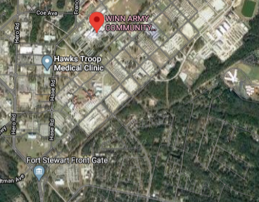
Site 5 – Hospital CASEVAC
Vignette Scenario: Effects from Vignette s #1 and #2 (downwind toxic plume) forces medical response, medical triage, evacuation and treatment.
Training Objective #1: Validate the Fort Stewart Garrison Emergency Management Plan. Establish and maintain a unified and coordinated operational structure and processes that appropriately integrate all critical stakeholders and supports the execution of Core Capabilities.
Training Objective #3: Validate the EFAC plan by providing life-sustaining and human services to the affected population, to include hydration, feeding, sheltering, temporary housing, evacuee support, reunification, and distribution of emergency supplies.
Vignette Core Capabilities Exercised:
CC1. Planning
CC2. Public Information & Warning
CC3. Operational Coordination
CC4. Intelligence and Information Sharing
CC11. Community Resilience
CC13. Threat & Hazard Identification
CC15. Env. Response/Health & Safety
CC20. Mass Care Services
CC22. On-Scene Security, Protection & LE
CC23. Operational Communications
CC24. Public Health and Medical Services
CC25. Situational Assessment
CC26. Health & Social Services
5
EXAMPLE
HOSPITAL
Controller:
Phone:
LMR Freq:

