Slide 1
FY21 Full-Scale Exercise
Adam F. Buehler
Installation Emergency Manager
Directorate of Plans, Training, Mobilization and Security
Orbit Commit 2021
Version 8
As of 7 Oct 2020

Slide 2
Training Objectives
1: Validate the Fort Bragg Garrison Emergency Management Plan. Establish and maintain a unified and coordinated operational structure and processes that appropriately integrate all critical stakeholders and supports the execution of Core Capabilities.
2: Demonstrate Fort Bragg’s ability to deliver coordinated, prompt, reliable, and actionable information to the whole community through the use of clear, consistent, accessible, other appropriate methods to effectively relay information regarding any threat or hazard and, as appropriate, the actions being taken and the assistance being made available.
3. Validate the EFAC plan by providing life-sustaining and human services to the affected population, to include hydration, feeding, sheltering, temporary housing, evacuee support, reunification, and distribution of emergency supplies.
4. Conduct appropriate measures to ensure the protection of the health and safety of the public and workers, as well as the environment, from all hazards in support of responder operations and the affected communities. Detect, assess, stabilize, and clean up releases of hazardous materials into the environment, including buildings/structures, and properly manage waste.
5. Conduct a Recovery Planning Process, engaging the whole community as appropriate in the development of executable strategic, operational, and/or tactical-level approaches to address all core capabilities, and integrates socioeconomic, demographic, accessibility, technology, and risk assessment considerations, which will be implemented in accordance with the timeline contained in the plan.

Slide 3
Targeted Core Capabilities
Required:
CC1. Planning
CC2. Public Information & Warning
CC3. Operational Coordination
CC4. Intelligence and Information Sharing
CC13. Threat & Hazard Identification
CC15. Environmental Response/Health & Safety
CC22. On-Scene Security, Protection & LE
CC23. Operational Communications
CC24. Public Health and Medical Services
CC25. Situational Assessment
Additional:
CC11. Community Resilience
CC14. Critical Transportation
CC16. Fatality Management Services
CC20. Mass Care Services
CC26. Health & Social Services

Slide 4
FSE ORBIT COMET-21 Scenario
Shortly following the conclusion of FSE ORBIT COMET-19, Ft. Bragg has reduced it’s FPCON posture to B(+) and returned operations to a steady-state level.
Two of the four personnel who had successfully infiltrated the installation during ORBIT COMET-19 (and remained undetected) detonate a tanker filled with a Class III HazMat (Acetonitrile) near the Pope Airfield Hanger causing a MASCAL event, multiple fatalities, HazMat release and a toxic plume traveling SE across Silver Ramp and the runway towards the Pope Soldier Readiness Center.

Slide 5
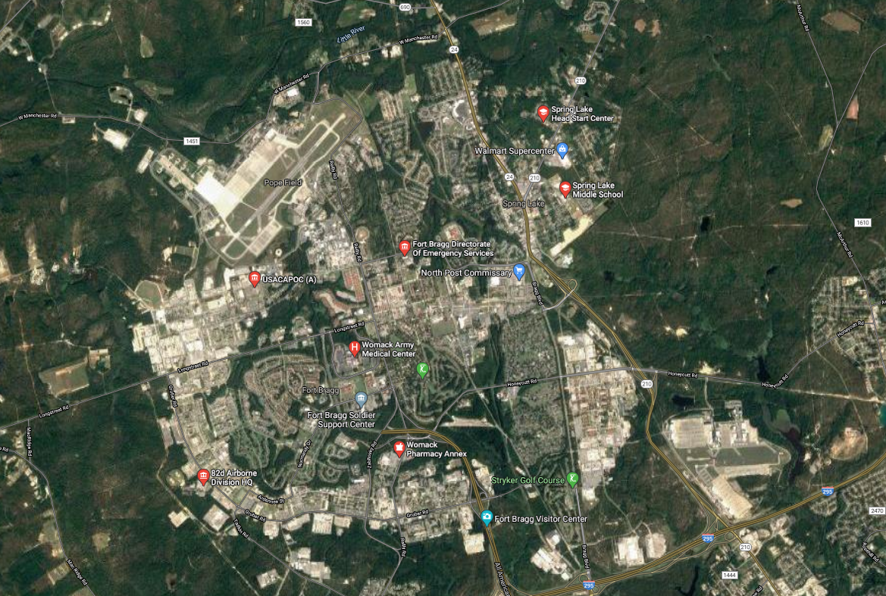
Full-Scale Exercise Overview
HAZMAT Explosion
MASCAL
Toxic Plume
1
2
EOC
EFAC
3
5
4
CASEVAC

Slide 6
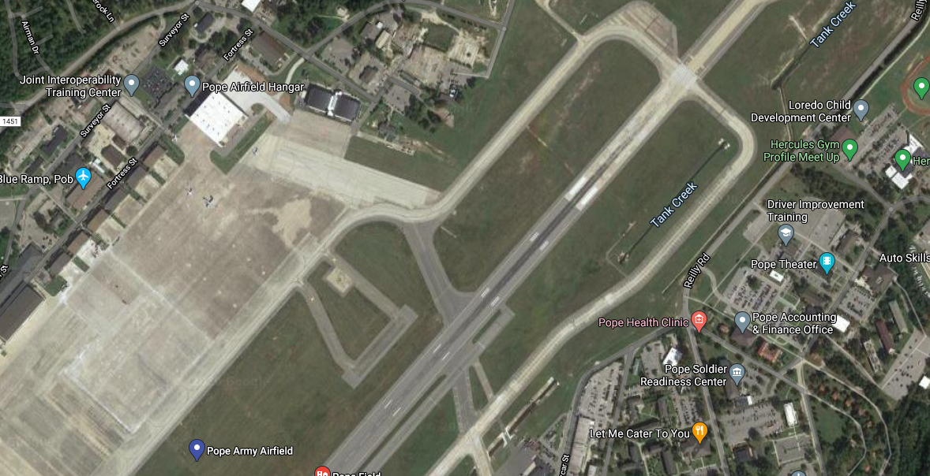
Site – HAZMAT Explosion
Vignette Scenario: During a Class 3 HAZMAT (Acetonitrile) transportation, a 15,000gal tanker explodes via terrorist action on W. Manchester road between Airman Drive and Bluerock Ln, with the plume traveling SE across the Joint Interoperability Training Center, the Pope Airfield Hanger, Silver ramp, and across the runway towards the Pope Soldier Readiness Center area.
Training Objective #3: Validate the EFAC plan by providing life-sustaining and human services to the affected population, to include hydration, feeding, sheltering, temporary housing, evacuee support, reunification, and distribution of emergency supplies.
Training Objective #4: Conduct appropriate measures to ensure the protection of the health and safety of the public and workers, as well as the environment, from all hazards in support of responder operations and the affected communities. Detect, assess, stabilize, and clean up releases of hazardous materials into the environment, including buildings/structures, and properly manage waste.
Training Objective #5: Conduct a Recovery Planning Process, engaging the whole community as appropriate in the development of executable strategic, operational, and/or tactical-level approaches to address all core capabilities, and integrates socioeconomic, demographic, accessibility, technology, and risk assessment considerations, which will be implemented in accordance with the timeline contained in the plan.
Vignette Core Capabilities Exercised:
CC1. Planning
CC2. Public Information & Warning
CC3. Operational Coordination
CC4. Intelligence and Information Sharing
CC13. Threat & Hazard Identification
CC14. Critical Transportation
CC15. Environmental Response/Health & Safety
CC16. Fatality Management Services
CC20. Mass Care Services
CC22. On-Scene Security, Protection & LE
CC23. Operational Communications
CC24. Public Health and Medical Services
CC25. Situational Assessment
CC26. Health and Social Services
HAZMAT Explosion
Toxic Plume
1
Evacuation Area
2
Expected Player Action:
Fire/HazMat identification & response; Mass notification, public messaging, Shelter in Place – Evacuation, MASCAL, fatality management operations, TWG assessment, FPCON changes, airfield closure (NOTAM), mass search and rescue, mass care operations, personnel accountability, establish EFAC and shelter, reunification, building/airfield remediation, RWG planning, Joint Information Center, press conference, etc.
Controller:
Phone:
LMR Freq:

